Slide 1
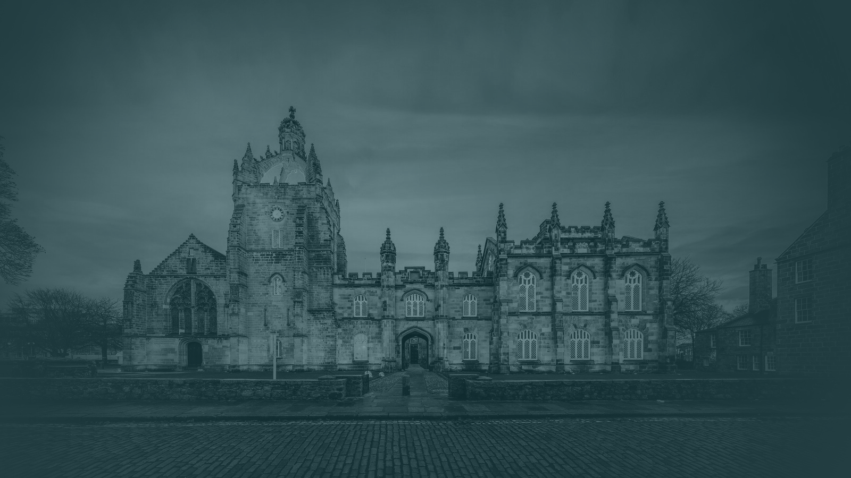
Elphinstone Research Group
Discounted Cash Flow

Slide 2

Elphinstone Research Group
Time Value of Money
The Time Value of Money (TVM) is the concept that a pound sterling today is worth more than a pound that you may receive tomorrow.
In the context of DCF, the time value of money is the reason we discount future cash flows.
Future Value (FV)
Present Value (PV)
FV = PV x (1+r)^{n}
PV = $\frac{FV}{\left(1+r\right)n}$
Scottish Registered Charity No. SC054318
ERG | 2

Slide 3

Elphinstone Research Group
What is FCF? (vs. Earnings)
Free Cash Flow per share measures a company’s financial flexibility by dividing free cash flow by outstanding shares, reflecting potential changes in earnings per share.
FCF is an indicator of a company’s capacity to pay debt, dividends and repurchase stock.
Free Cash Flow per Share = $\frac{Free Cash Flow}{\# Shares Outstanding}$
Free Cash Flow vs Earnings (Net Income)
FCF – Represents spendable cash, and excludes non-cash related items found on income and cash flow statements, accounts for the actual timing of cash entering and leaving.
Earnings – Includes non-cash items but excludes capital expenditure, records revenue when a sale is made
Scottish Registered Charity No. SC054318
ERG | 3

Slide 4
Elphinstone Research Group
Calculating Unlevered FCF
Unlevered Free Cash Flow (UFCF) is the cash flow a company generates from its core operations before accounting for interest and taxes. In contrast, levered FCF takes into account interest and taxes.
Unlevered FCF is crucial in financial modelling for valuing a company’s Enterprise Value
UFCF = [EBIT x (1-t)] + D&A – CapEx - ΔNWC
UFCF is the preferred metric when performing DCF analysis, as it allows you to value the company’s core operations independent of its capital structure.
Scottish Registered Charity No. SC054318
ERG | 4

Slide 5
Elphinstone Research Group
Change in Net Working Capital
Net Working Capital represents the company’s efficiency and ability to meet short-term obligations.
Unlevered FCF is crucial in financial modelling for valuing a company’s Enterprise Value
NWC = CA (excluding cash) – CL (excluding debt)
The ideal position for a company is to have more current assets than current liabilities and thus have a positive net working capital balance.
Scottish Registered Charity No. SC054318
ERG | 5

Slide 6
Elphinstone Research Group
Weighted Average Cost of Capital
The Weighted Average Cost of Capital is the discount rate for future cash flows into today’s money.
It is a critical metric to assess if a company is generating or losing value.
WACC = ($\frac{E}{V}$ x Re) + ($\frac{D}{V}$ x Rd) x (1-t))
The higher the risk of the company, the higher the WACC, and the lower the valuation will be today.
Scottish Registered Charity No. SC054318
ERG | 6

Slide 7
Elphinstone Research Group
Terminal Value
Terminal value estimates future cash flows beyond a set period, discounting them to present value.
It is a critical metric to assess if a company is generating or losing value.
Exit Multiple Method
Terminal Value = Final Year EBITDA x Exit Multiple
Perpetuity Growth Model
Terminal Value = $\frac{Final Year FCF x (1+Perpetuity Growth Rate)}{(Discount Rate −Perpetuity Growth Rate)}$
Scottish Registered Charity No. SC054318
ERG | 7

Slide 8
Elphinstone Research Group
Present Value of Terminal Value
The Weighted Average Cost of Capital is the discount rate for future cash flows into today’s money.
Formula for Present Value of Terminal Value: Terminal Value / Discount Factor
PV of TV = $\frac{TV}{\left(1+WACC\right)n}$
Scottish Registered Charity No. SC054318
ERG | 8

Slide 9
Elphinstone Research Group
From Enterprise Value to Share Price
It is crucial that after all the complex forecasting and discounting, when you are left with the Enterprise Value (EV), you calculate the share price.
To get there we must perform what is known as the Equity Value Bridge
Equity Value
Equity Value = Enterprise Value - Net Debt - Preferred Stock - Minority Interest
Share Price
Implied Share Price = $\frac{Equity Value}{Diluted Shares Outstanding}$
Scottish Registered Charity No. SC054318
ERG | 9

Slide 10
Elphinstone Research Group

