Slide 1

Elphinstone Research Group
Modern Portfolio Theory

Slide 2
Elphinstone Research Group
Contents
Introduction to Modern Portfolio Theory – pg. 3
Correlation – pg. 4
Covariance & Correlation Matrix – pg. 5
Mean-Variance Theory – pg. 6
2-Asset Portfolio Example – pg. 8
Sharpe Ratio – pg. 10
Minimum-Variance Frontier– pg. 11
Optimal Complete Portfolio – pg. 12
Capital Allocation Line – pg. 13
Capital Market Line – pg. 14
Mathematical Derivation of GMVP – pg. 15
Scottish Registered Charity No. SC054318 | For Educational Purposes Only
ERG | 2

Slide 3
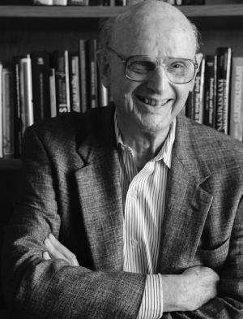
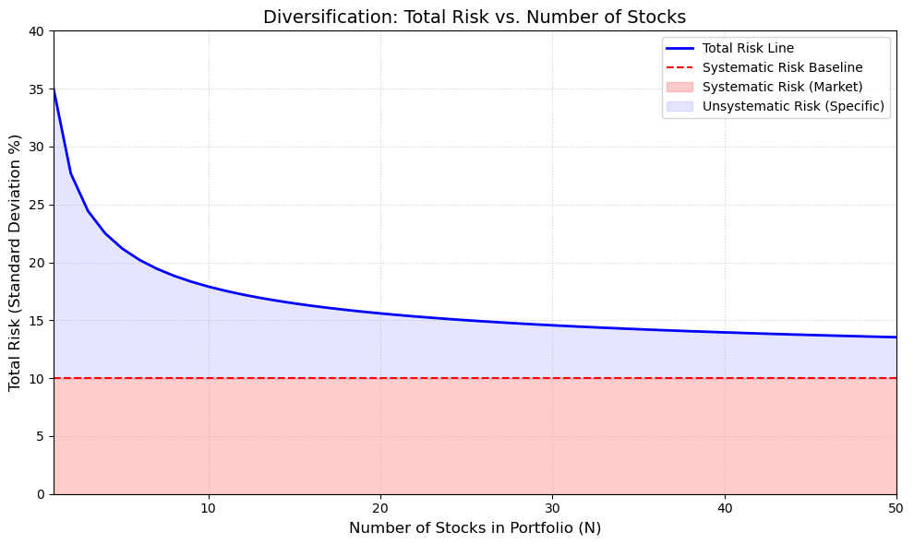
Elphinstone Research Group
Introduction to Modern Portfolio Theory
Developed by Harry Markowitz in 1952, the Modern Portfolio Theory framework introduced the concepts of risk, return and diversification in portfolio management. This framework allows investors to put together a portfolio of assets that will maximise the expected return for a given level of risk, and it introduces the key concept of diversification. Its goal is to achieve the optimal balance between risk and return by appropriately diversifying its assets among many diverse and uncorrelated asset classes. The investment decision is not merely which securities to own, but how to divide the investor's wealth among those securities.
Harry Markowitz
$$Diversification$$
Diversification is achieved by choosing an optimal mix based on the investor’s risk tolerance. Diversification in portfolio allocation aims to minimise firm-specific risk by combining assets that are not perfectly positively correlated
Scottish Registered Charity No. SC054318 | For Educational Purposes Only
ERG | 3

Slide 4
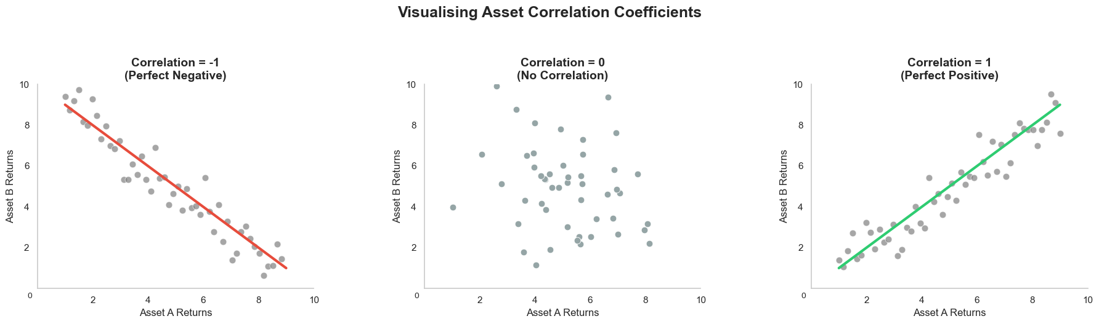

Elphinstone Research Group
Correlation
Correlation is measured using the correlation coefficient, ρ, which ranges from -1 to 1 and indicates the strength and direction of a relationship between variables.
ρ = -1 shows perfect negative correlation between two assets.
$$ρ=\frac{σ_{12}}{σ_{1}σ_{2}}$$
ρ = 1 shows a perfect positive correlation between two assets
Scottish Registered Charity No. SC054318 | For Educational Purposes Only
ERG | 4

Slide 5
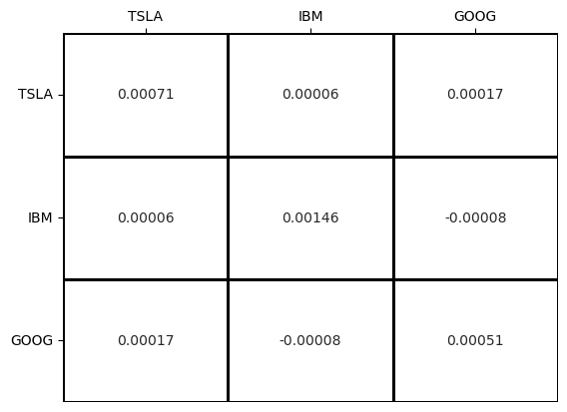
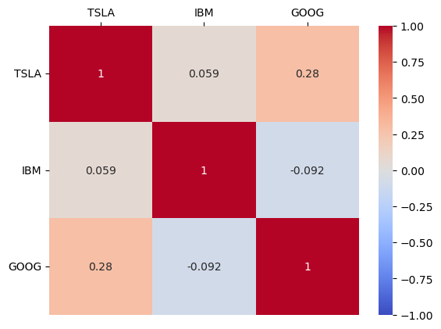

Elphinstone Research Group
Covariance & Correlation Matrix
The Covariance Matrix measures the direction and the scale of how two assets move together using raw returns. If we standardise these numbers by their variances, we get the Correlation, which is strictly bounded between -1 and +1.
Covariance Matrix
Correlation Matrix
$$ρ=\frac{σ_{12}}{σ_{1}σ_{2}}$$
Scottish Registered Charity No. SC054318 | For Educational Purposes Only
ERG | 5

Slide 6

Elphinstone Research Group
Mean-Variance Theory
According to the mean-variance theory, an investor should choose from among the efficient portfolios consistent with their risk tolerance.
$${E(R}_{A})≥{E(R}_{B})$$
$$σA≤σB$$
$$Portfolio Risk \& Return Formulas$$
Total Weight
$$w1+w2=1$$
$$Rp=w1R1+w2R2$$
Portfolio Return
Scottish Registered Charity No. SC054318 | For Educational Purposes Only
ERG | 6

Slide 7


Elphinstone Research Group
Mean-Variance Theory
$$Portfolio Risk \& Return Formulas (continued)$$
$σp2=w12 σ12+$ $w22 σ22+2w1w2Cov(R1,R2)$
Portfolio Variance
2 Assets
$Cov(R1,R2)$ = $ρ12σ1σ2$
$σp2=w12 σ12+$ $w22 σ22+2w1w2ρ12σ1σ2$
$$σp2=\sum_{i=1}^{n}{wi2 σi2}+\sum_{i=i}^{n}{\sum_{\begin{aligned}j=i \\ i≠j\end{aligned}}^{n}{wi wjρij}}σiσj$$
Portfolio Variance
n Assets
Scottish Registered Charity No. SC054318 | For Educational Purposes Only
ERG | 7

Slide 8
Elphinstone Research Group
2-Asset Portfolio Example
Asset 1 (Bond):
w₁ = 0.5, E(R₁)= 0.04 (4%), σ₁ = 0.05 (5%)
Asset 2 (Stock):
w₂ = … , E(R₂)= 0.12 (12%), σ₂ = 0.20 (20%)
$$w2=1−w1=1−0.5=0.5$$
$$Rp=w1R1+w2R2=0.5×0.04+0.5×0.12=8\%$$
$σp2=w12 σ12+$ $w22 σ22+2w1w2ρ12σ1σ2$
$$σp2=0.52× 0.052+0.52 ×0.202+2×0.5×0.5×1×0.05×0.2 =0.015625$$
$$σp= \sqrt{0.015625}=0.125 or 12.5\%$$
$$0.5×0.05+0.5×0.20 =0.125 or 12.5\%$$
Weighted Average Standard Deviation:
There will be no diversification benefit
Scottish Registered Charity No. SC054318 | For Educational Purposes Only
ERG | 8

Slide 9
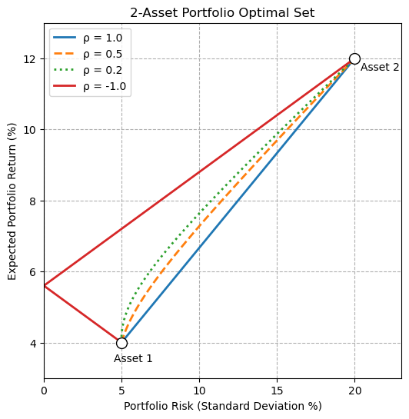
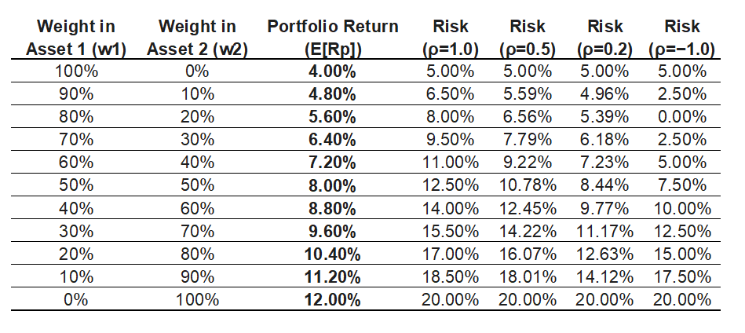
Elphinstone Research Group
2-Asset Portfolio Example
Risk-Return Matrix across Correlations
Scottish Registered Charity No. SC054318 | For Educational Purposes Only
ERG | 9

Slide 10
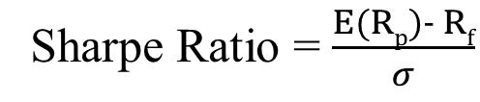
Elphinstone Research Group
Sharpe Ratio
The Sharpe Ratio, introduced by William F. Sharpe, compares an investment’s return with its risk. It shows whether a portfolio’s excess returns are attributable to smart investment decisions or luck and risk.
The numerator represents the risk premium, the difference between expected returns and the risk-free rate of return.
The denominator is the portfolio standard deviation of returns over the same period.
Sharpe Ratio = $\frac{E(Rp)− Rf}{σ}$
In Modern Portfolio Theory, the Sharpe ratio is used to find the Optimal Risky Portfolio, also known as the Market Portfolio, by finding the portfolio with the maximum Sharpe ratio. This portfolio is also known as the point where the Capital Market Line has a tangency with the efficient frontier.
Scottish Registered Charity No. SC054318 | For Educational Purposes Only
ERG | 10

Slide 11
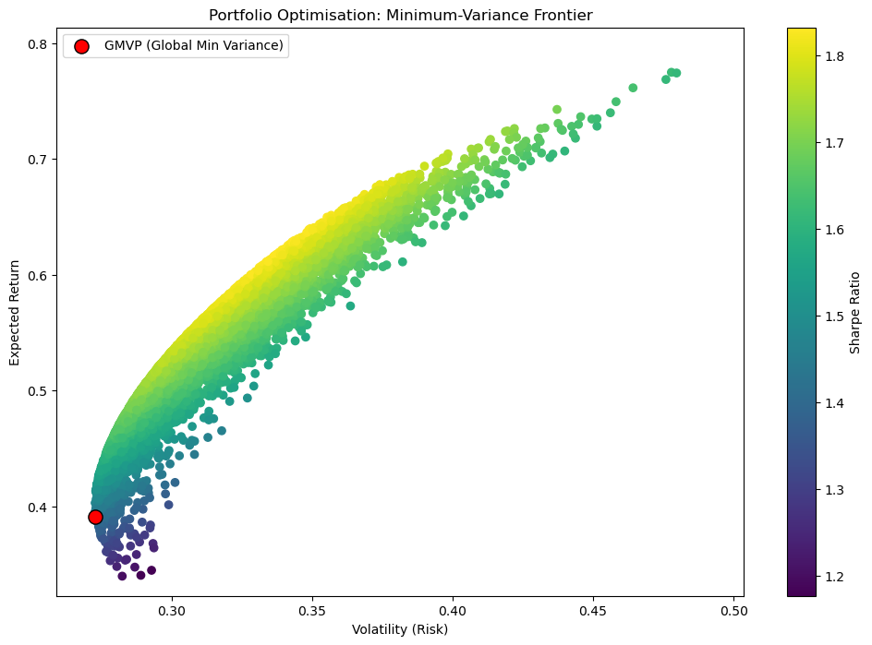
Elphinstone Research Group
Minimum-Variance Frontier
The Efficient Frontier shows all possible efficient portfolios. Efficient portfolios plot graphically on the efficient frontier, which is part of the minimum-variance frontier (MVF)
The Global Minimum Variance Portfolio is the point on the frontier with the smallest variance of all minimum-variance portfolios.
Efficient Portfolios provide the highest expected return for a given level of risk.
Scottish Registered Charity No. SC054318 | For Educational Purposes Only
ERG | 11

Slide 12
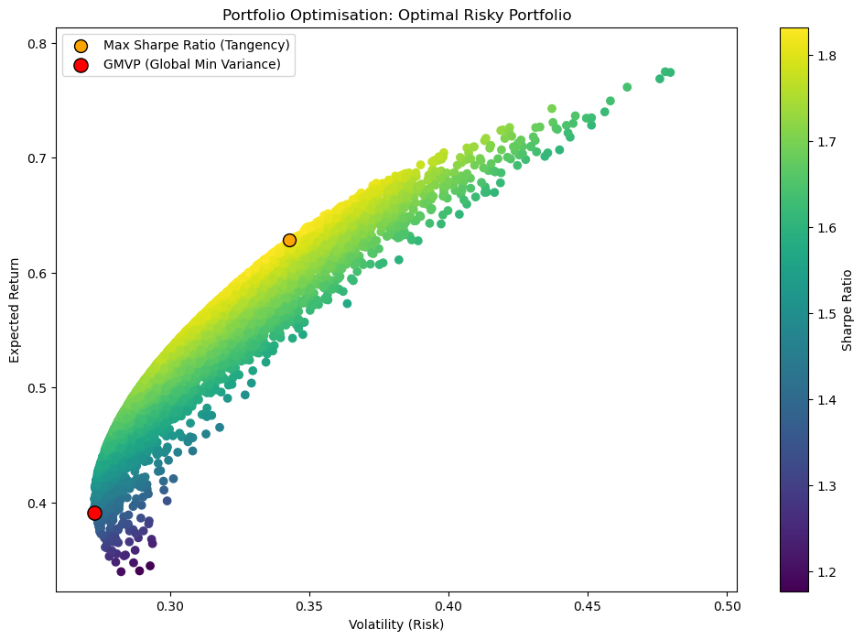
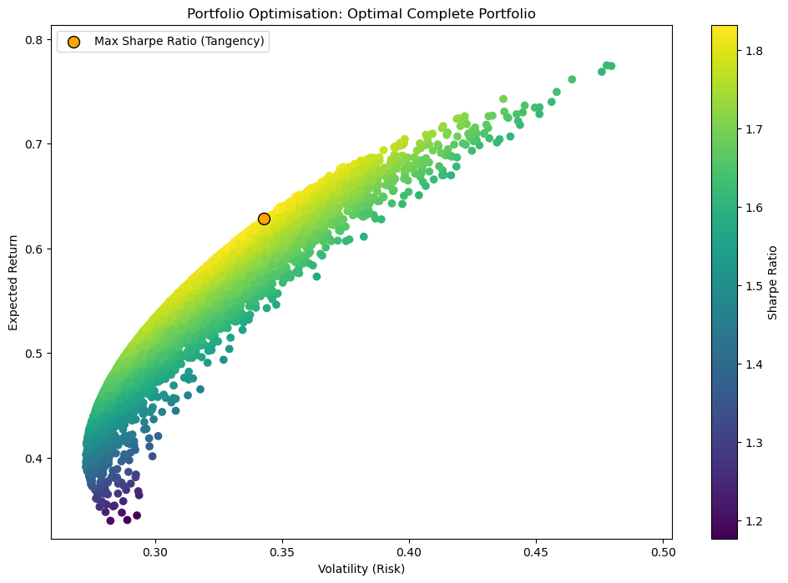

Elphinstone Research Group
Optimal Risky Portfolio
The Optimal Risky Portfolio, also known as the Market Portfolio, is the combination of assets that will provide the highest Sharpe ratio.
The optimal risky portfolio is found at the point where the CML is tangent to the efficient frontier.
Maximise $\frac{E(Rp)− Rf}{σ}$
Scottish Registered Charity No. SC054318 | For Educational Purposes Only
ERG | 12

Slide 13
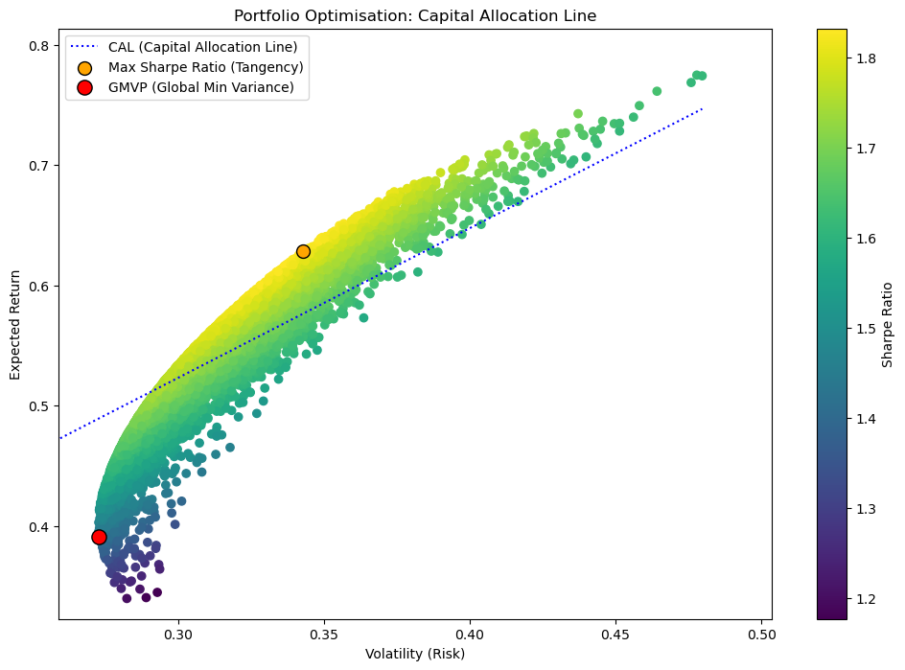

Elphinstone Research Group
Capital Allocation Line
The Capital Allocation Line represents the linear relationship between risk and return combinations in portfolios that mix a risk-free asset with risky assets.
The optimal CAL is known as the Capital Market Line
The slope of the CAL is the Sharpe ratio, and it represents the reward-to-risk ratio, measuring the excess return an investor receives per unit of total risk.
Scottish Registered Charity No. SC054318 | For Educational Purposes Only
ERG | 13

Slide 14
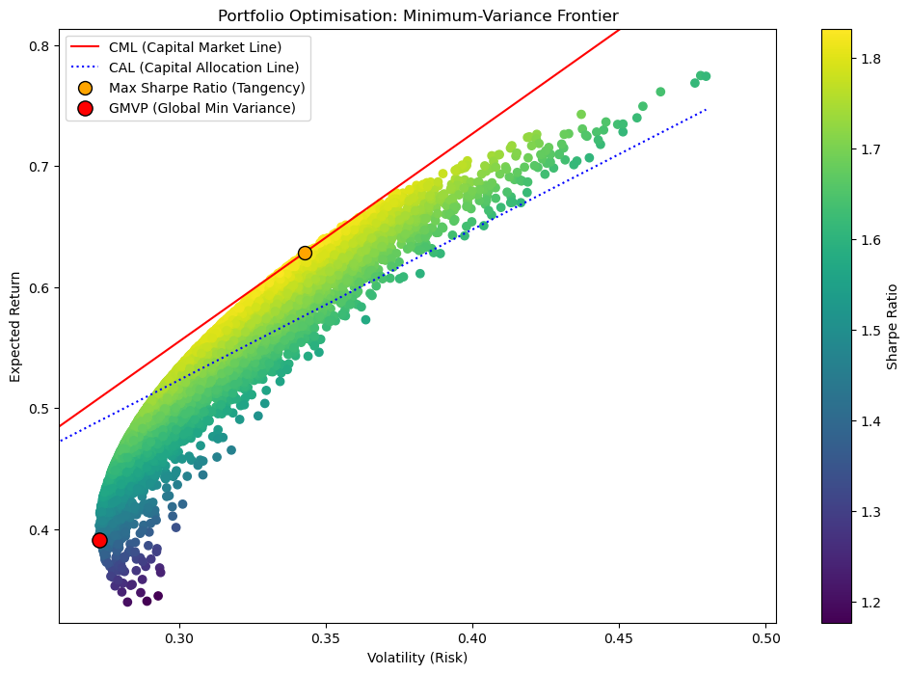

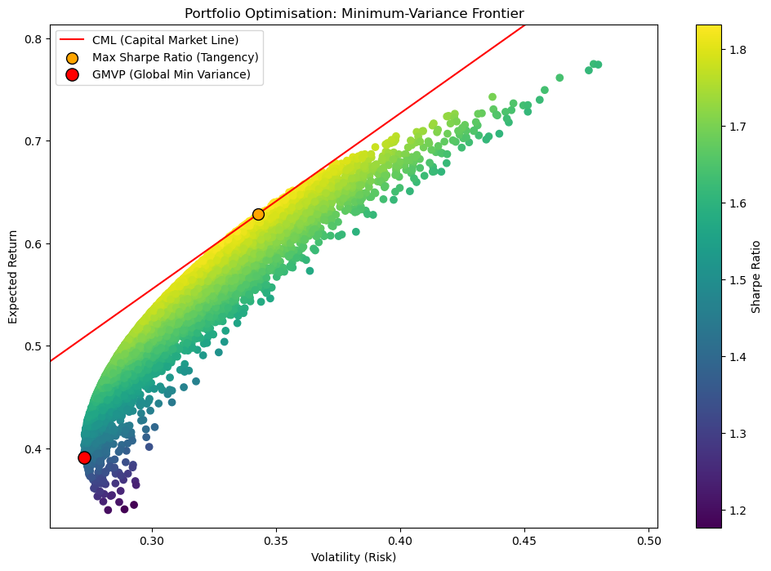


Elphinstone Research Group
Capital Market Line
The CAL with the highest Sharpe Ratio is the Capital Market Line.
The Capital Market Line is tangent to the efficient frontier.
The Capital Market Line assumes all portfolios are perfectly efficient and fully diversified.
Risk-averse investors will select portfolios close to the risk-free asset. Risk-seeking investors will prefer leveraged allocations higher up on the CML.
Scottish Registered Charity No. SC054318 | For Educational Purposes Only
ERG | 14

Slide 15
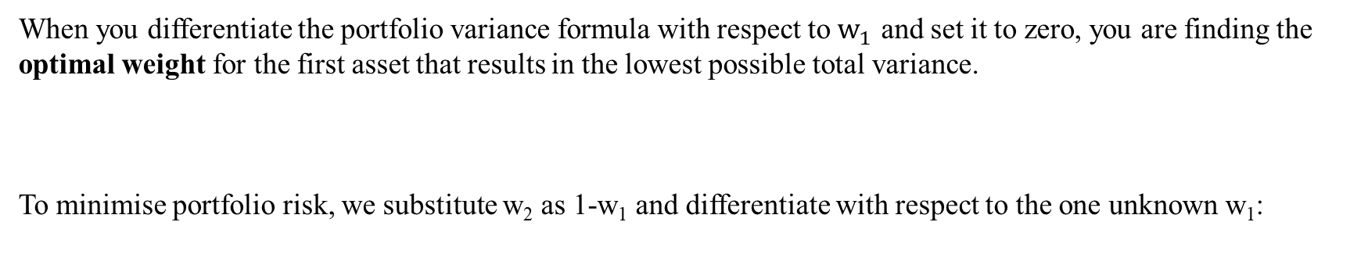
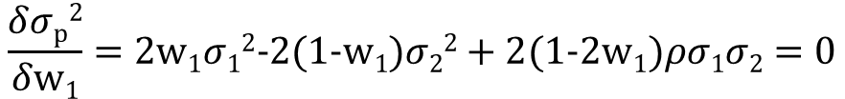
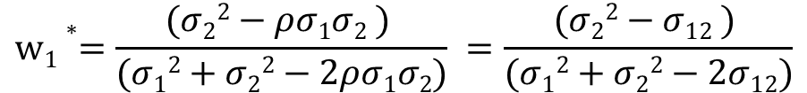
Elphinstone Research Group
Mathematical Derivation of GMVP
When you differentiate the portfolio variance formula with respect to $w_{1}$ and set it to zero, you are finding the optimal weight for the first asset that results in the lowest possible total variance.
To minimise portfolio risk, we substitute w₂ as 1-w₁ and differentiate with respect to the one unknown w₁:
$σp2=w12 σ12+$ $w22 σ22+2w1w2ρ12σ1σ2$
$$\frac{δσp2}{δw1}=2w1σ12−2(1−w1)σ22+2(1−2w1)ρσ1σ2=0$$
$$w1∗=\frac{(σ22−ρσ1σ2 ) }{(σ12+σ22−2ρσ1σ2)} =\frac{(σ22−σ12 ) }{(σ12+σ22−2σ12)}$$
Scottish Registered Charity No. SC054318 | For Educational Purposes Only
ERG | 15

Slide 16
Elphinstone Research Group
Additional Resources
Investopedia https://www.investopedia.com/
Corporate Finance Institute (CFI) https://corporatefinanceinstitute.com/
ScienceDirect
Research Papers on Modern Portfolio Theory
Scottish Registered Charity No. SC054318 | For Educational Purposes Only
ERG | 9

